Slide 1
Docker Compose
Docker Compose

Slide 2
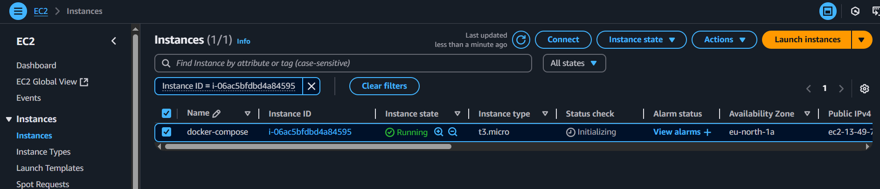
Docker Compose
Multiple container on single Host
Steps:1
1.Create a EC2 machine

Slide 3
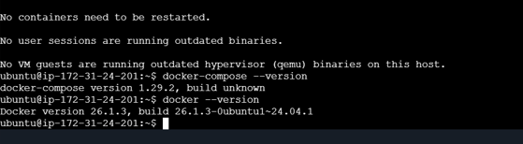
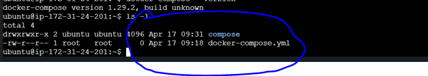
2.installation in EC2 Instance
Docker
Docker-compose
3.folder creation/Directory:

Slide 4
4.file creation (docker compose file)
create the docker compose file with .yaml extension
After that write a code into the YAML file (DATABASE & FrontEnd Application)
Mysql and Wordpress
Code:
version: ‘3.8’
services:
wordpress:
image: wordpress:latest
ports:
- 8080:80
environment:
WORDPRESS_DB_HOST: db
WORDPRESS_DB_USER: user
WORDPRESS_DB_PASSWORD:

Slide 5
WORDPRESS_DB_NAME: wordpress
depends_on:
- db
db:
image: mysql:5.7
environment:
MYSQL_DATABASE: wordpress
MYSQL_USER: user
MYSQL_PASSWORD: password
MYSQL_ROOT_PASSWORD: rootpassword
volumes:
- db_data:/var/lib/mysql
volumes:
db_data:

Slide 6
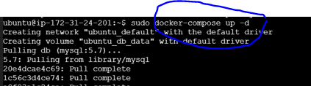

5.Docker-compose run the Container
Docker-compose
Mysql: get the mysql
Wordpress: get the image form docker hub

Slide 7
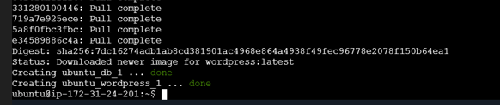
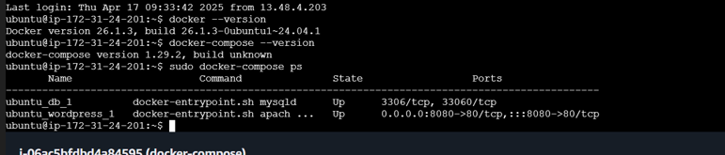
Completed
Verify:

Slide 8
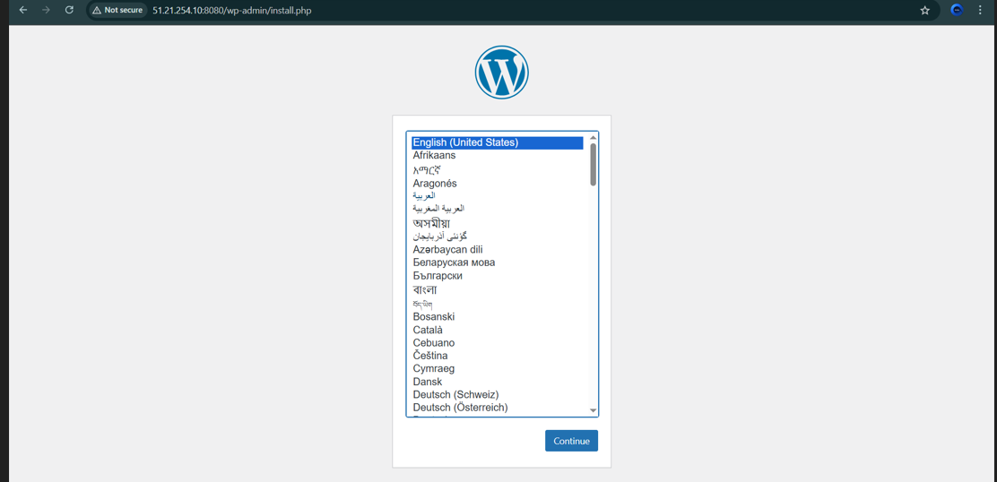
Step6:
Open a web browser and navigate to http:// 51.21.254.10:8080
see the "word Press!" webpage displayed in your web browser.
Loalhost- EC2 machine public IP : 51.21.254.10

Slide 9
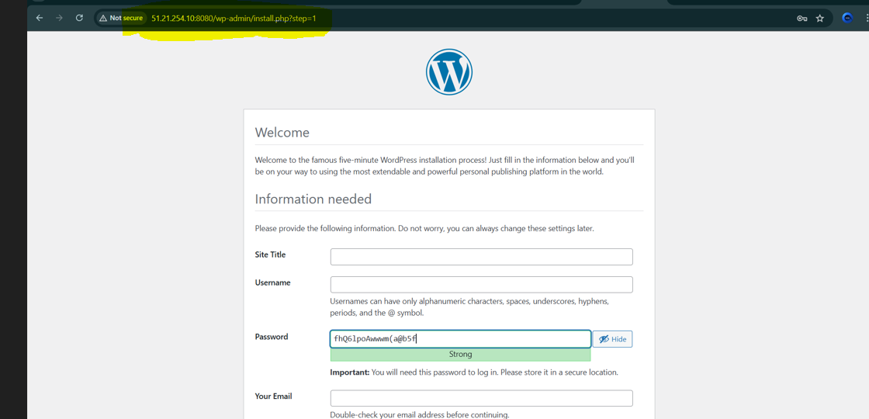
Result

Slide 10
Thank you

